Slide 1

Non-conforming isogeometric solid-shell coupling
Master Thesis in Computational Mechanics
Presenter: Minas Apostolakis
Supervisor: Aristio Ricky
Munich, 07. August 2025

Slide 2
Motivation and objectives
Motivation:
Couple solids and shells in B-REP IGA
Objectives:
Penalty and Nitsche’s method
Use solid elements and Kirchhoff-Love or Reissner-Mindlin (5pHierarchic) as shell elements
Linear static structural analysis

Slide 3
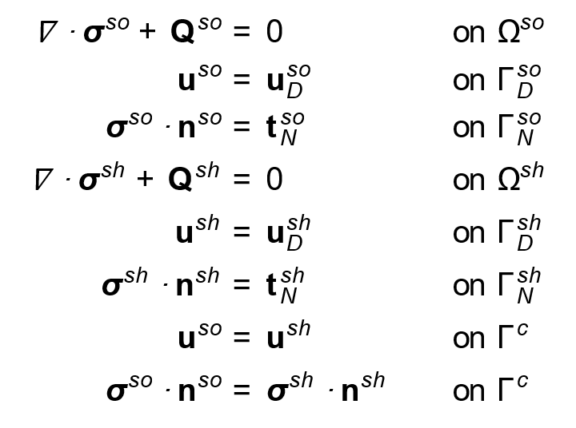
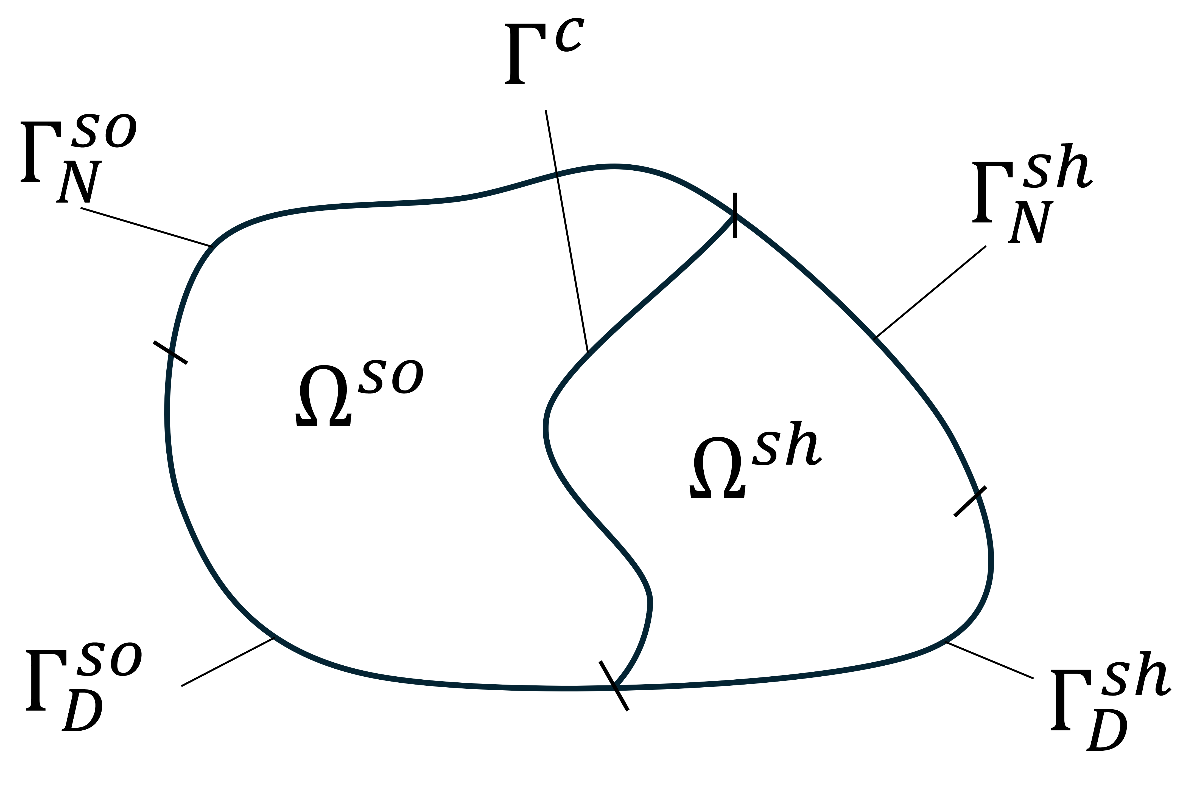
Boundary value problem
Decomposition of the problem’s domain

Slide 4
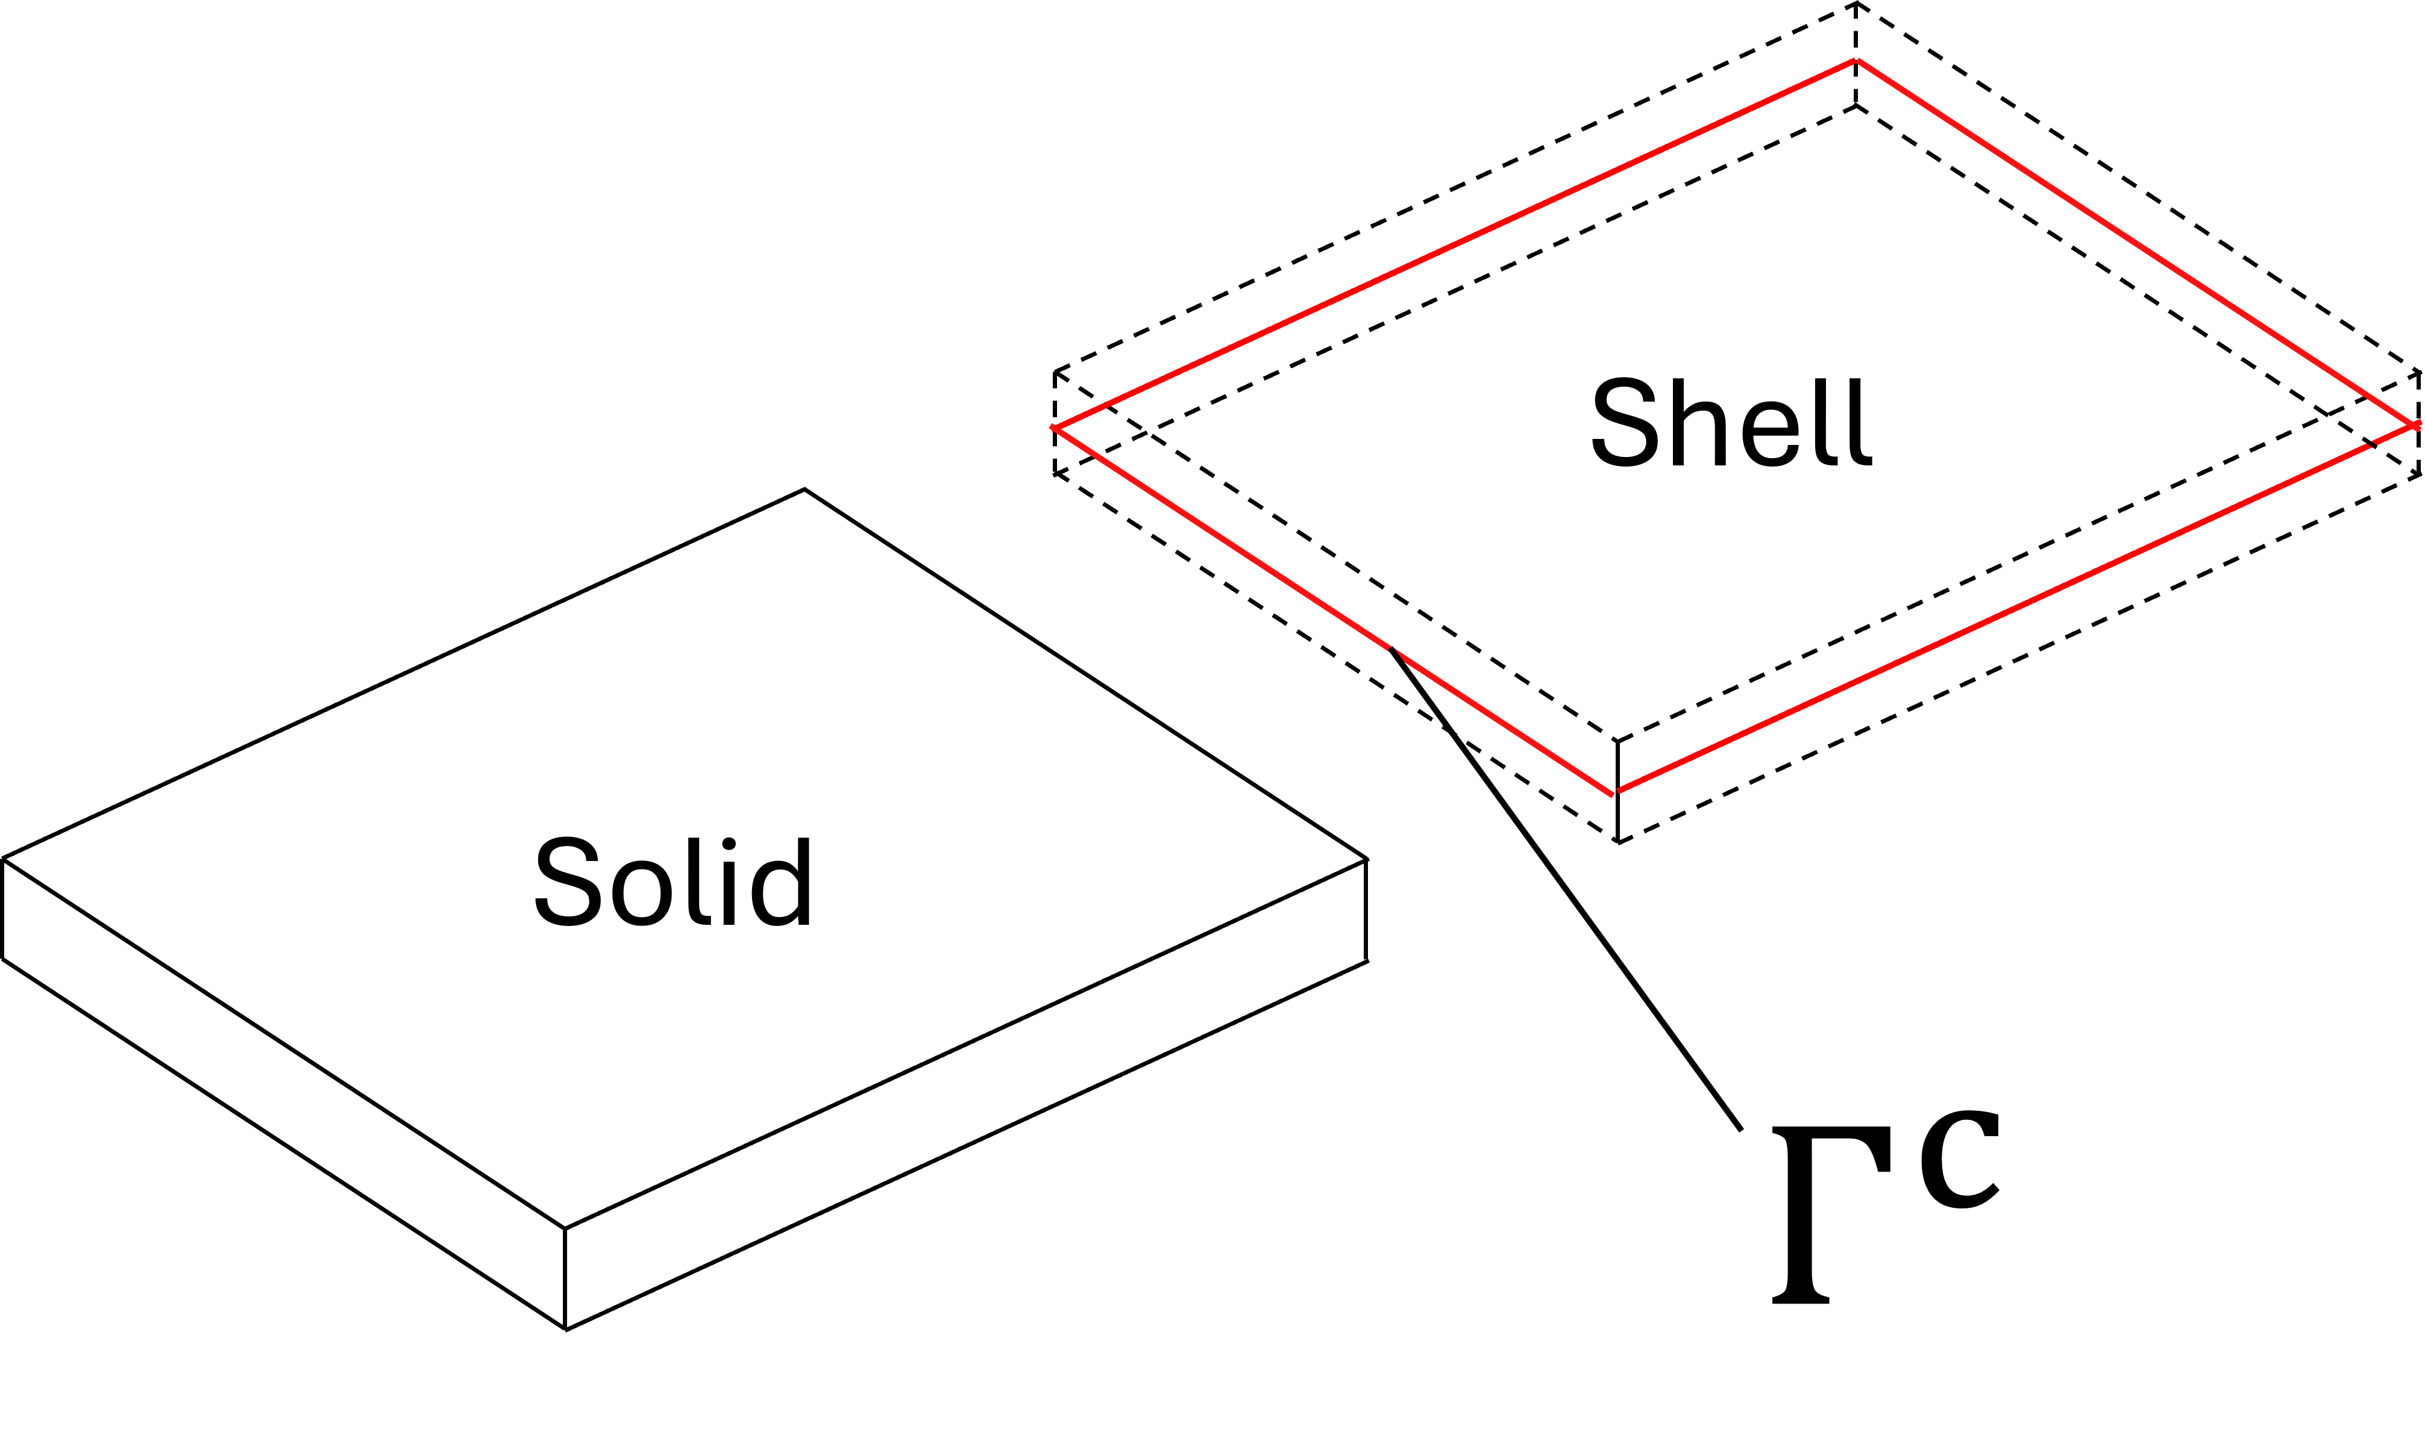
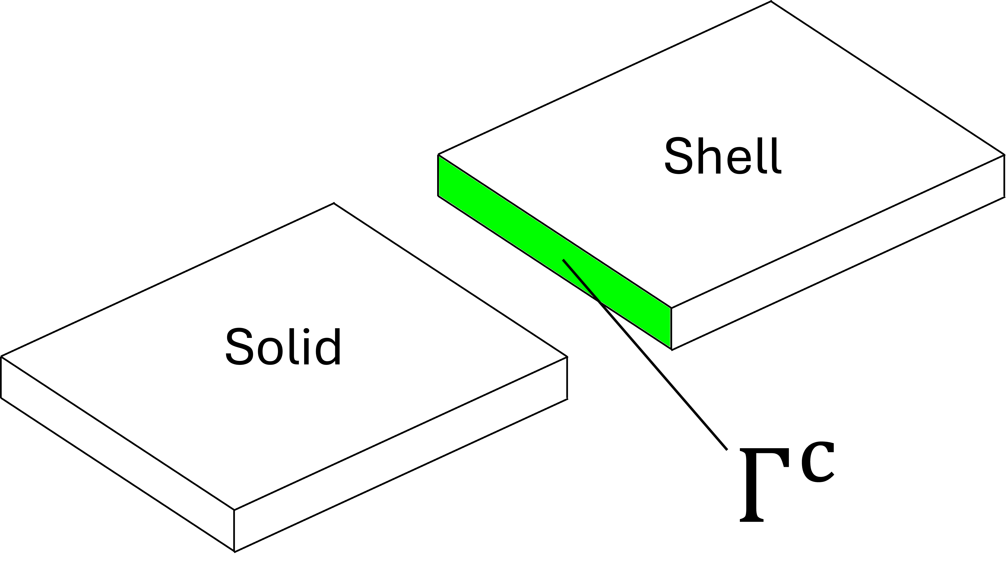
Coupling interface
❌
Solid shell coupling on the midsurface of the shell
✅
Decomposition of the problem’s domain
Solid shell coupling interface

Slide 5
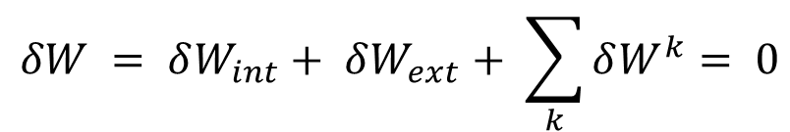
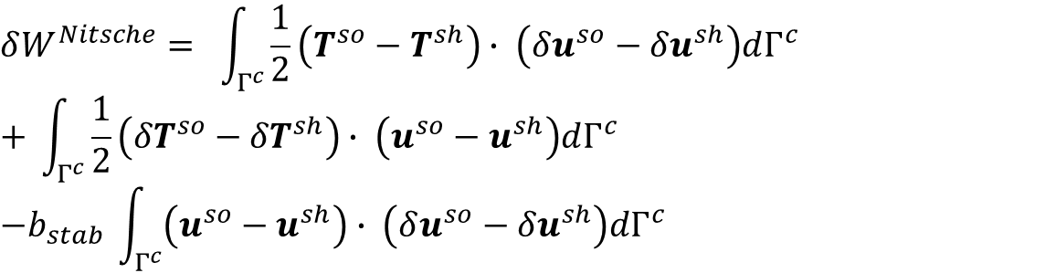
Principle of Virtual Work
Solid-shell coupling penalty terms
$$δW = δW_{int}+ δW_{ext}+ \sum_{k}{δW^{k}}= 0$$
Penalty/Nitsche’s terms for weak enforcement of Dirichlet BCs
Solid-shell coupling Nitsche’s terms
$$δW^{penalty}= −α_{pen} \int_{Γ^{c}}{\left(u^{so}−u^{sh}\right)∙ \left(δu^{so}−{δu}^{sh}\right)dΓ^{c}}$$
$$δW^{Nitsche}= \int_{Γ^{c}}{\frac{1}{2}\left(T^{so}−T^{sh}\right)∙ \left(δu^{so}−{δu}^{sh}\right)dΓ^{c}}$$
$$+ \int_{Γ^{c}}{\frac{1}{2}\left({δT}^{so}−{δT}^{sh}\right)∙ \left(u^{so}−u^{sh}\right)dΓ^{c}}$$
$$−b_{stab} \int_{Γ^{c}}{\left(u^{so}−u^{sh}\right)∙ \left(δu^{so}−{δu}^{sh}\right)dΓ^{c}}$$

Slide 6
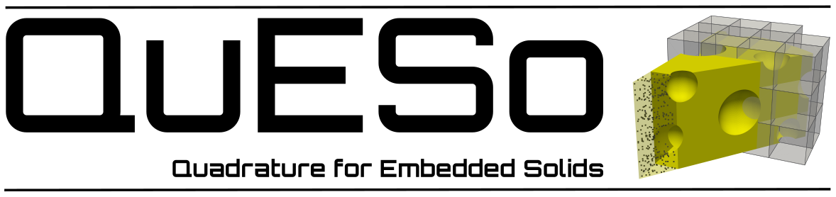
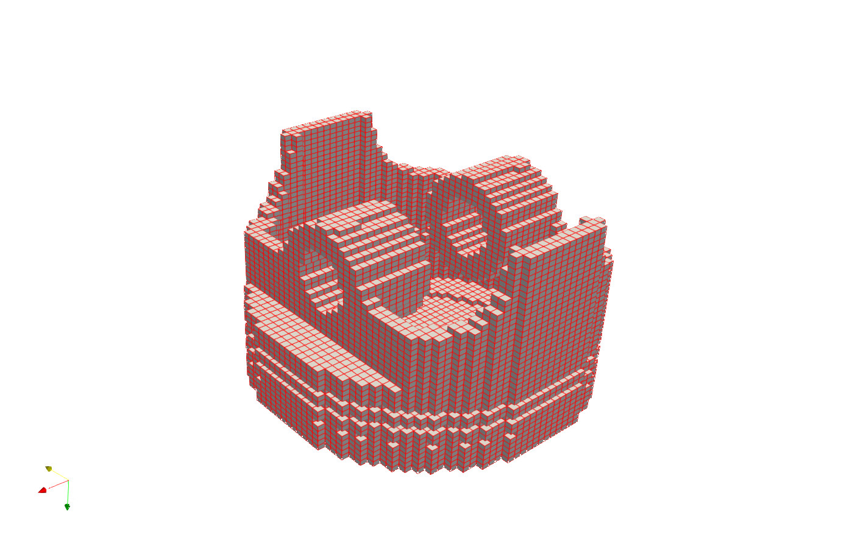
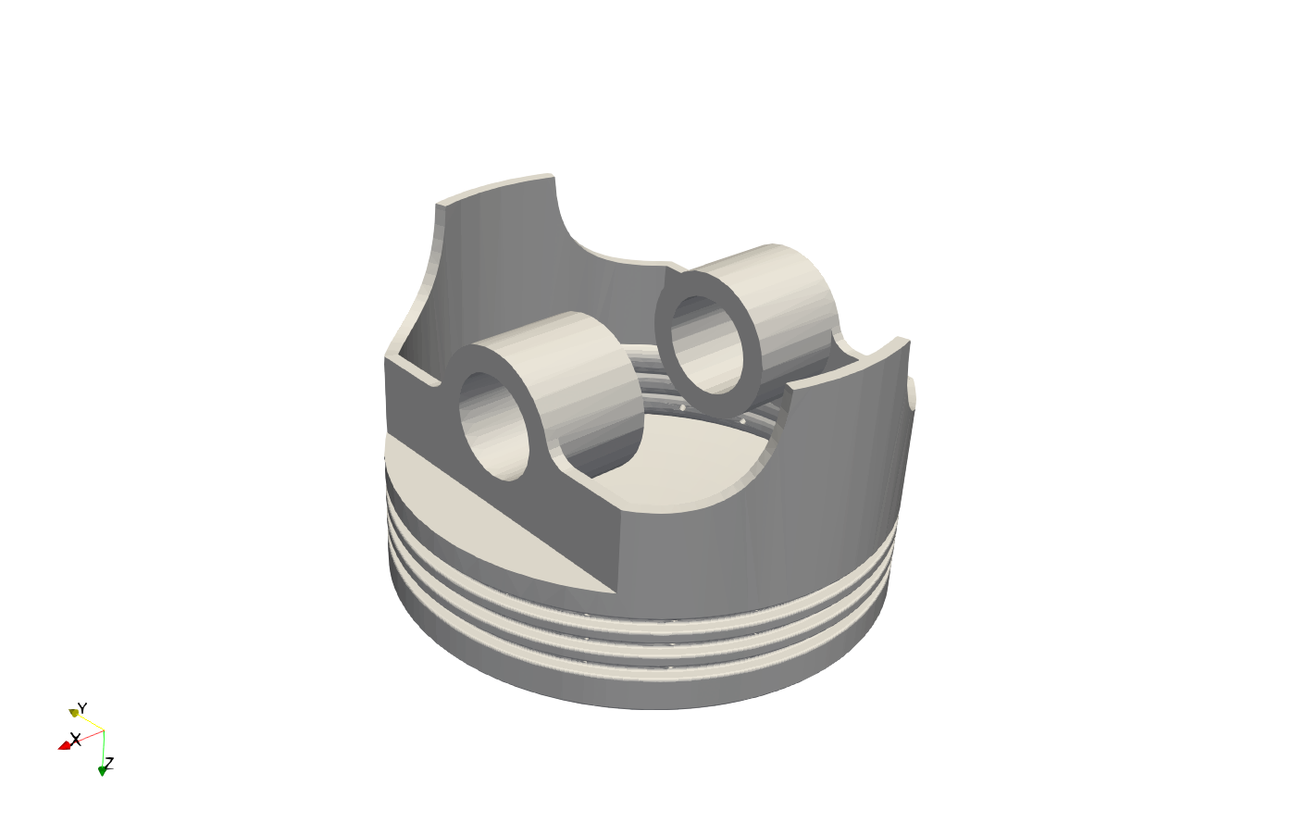
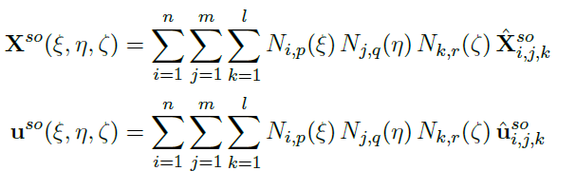
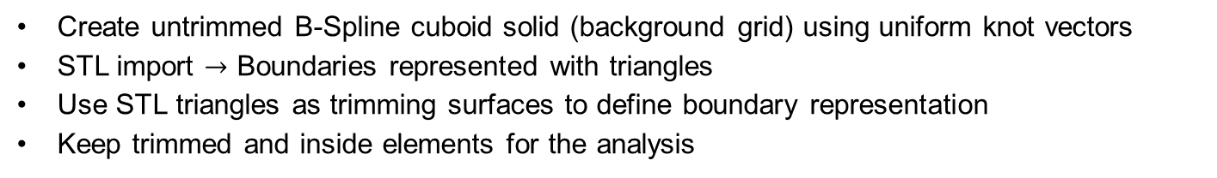
Solid discretization
Create untrimmed B-Spline cuboid solid (background grid) using uniform knot vectors
STL import $→$ Boundaries represented with triangles
Use STL triangles as trimming surfaces to define boundary representation
Keep trimmed and inside elements for the analysis
STL import model
Active elements of solid IGA model

Slide 7
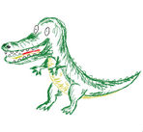

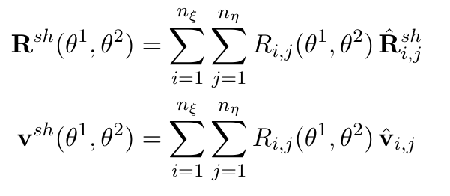
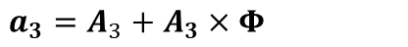
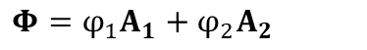
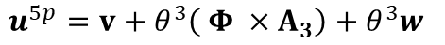
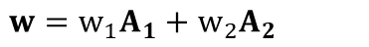
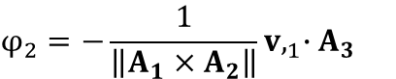
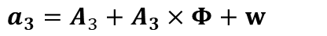
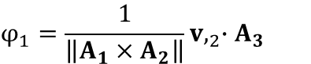
Shell discretization
NURBS basis functions instead of B-Splines
Edges for the boundary representation of the mid-surface
Shell kinematics
$$X\left(θ^{1},θ^{2},θ^{3}\right)=R\left(θ^{1},θ^{2} \right)+θ^{3}A_{3}\left(θ^{1},θ^{2} \right)$$
$$x\left(θ^{1},θ^{2},θ^{3}\right)=r\left(θ^{1},θ^{2} \right)+θ^{3}a_{3}\left(θ^{1},θ^{2} \right)$$
Kirchhoff- Love
Reissner-Mindlin (5pHierarhic)
$$a_{3}=A_{3}+A_{3}×Φ$$
$$a_{3}=A_{3}+A_{3}×Φ+w$$
$$Φ=φ_{1}Α_{1}+φ_{2}Α_{2}$$
$$φ_{1}=\frac{1}{\left\|Α_{1}×Α_{2}\right\|}v,_{2}∙A_{3}$$
$$w=w_{1}Α_{1}+w_{2}Α_{2}$$
$$φ_{2}=−\frac{1}{\left\|Α_{1}×Α_{2}\right\|}v,_{1}∙A_{3}$$
$$u^{3p}=x −X=v+θ^{3}\left( Φ ×Α_{3}\right)$$
$$u^{5p}=v+θ^{3}\left( Φ ×Α_{3}\right)+θ^{3}w$$

Slide 8
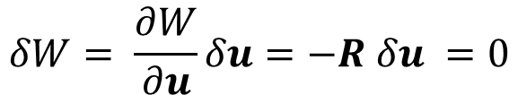
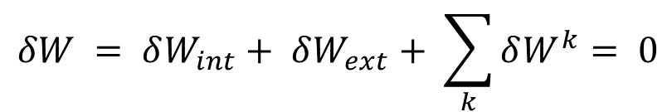
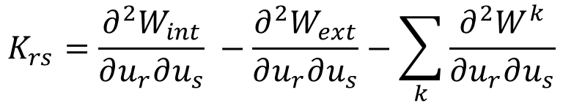
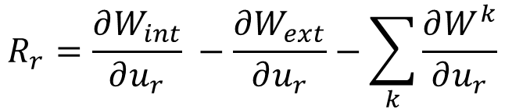
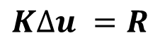
Solving strategy
Penalty terms
$$δW = δW_{int}+ δW_{ext}+ \sum_{k}{δW^{k}}= 0$$
Nitsche’s terms
$$δW= \frac{∂W}{∂u}δu=−R δu =0$$
$$R_{r}=\frac{∂W_{int}}{∂u_{r}} −\frac{∂W_{ext}}{∂u_{r}}−\sum_{k}{\frac{∂W^{k}}{∂u_{r}}}$$
$$KΔu =R$$
$$K_{rs}=\frac{∂^{2}W_{int}}{∂u_{r}∂u_{s}} −\frac{∂^{2}W_{ext}}{∂u_{r}∂u_{s}}−\sum_{k}{\frac{∂^{2}W^{k}}{∂u_{r}∂u_{s}}}$$

Slide 9
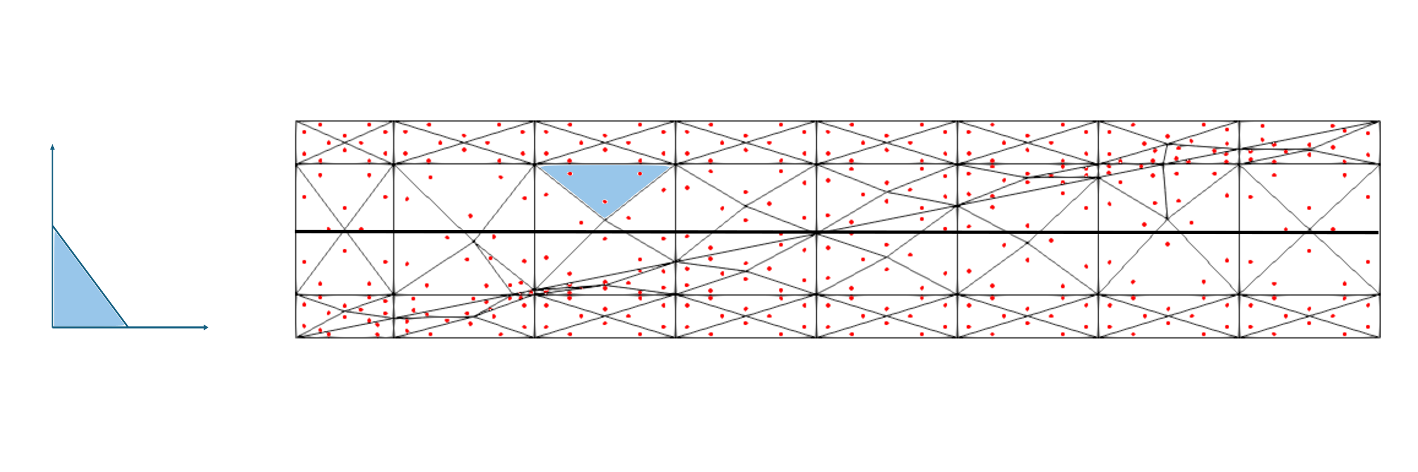
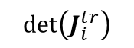
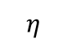
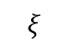
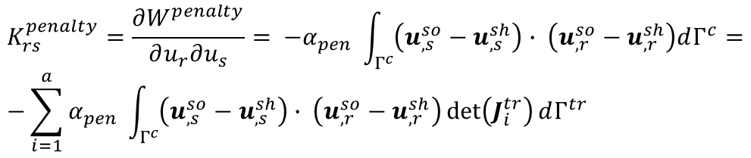
Integration on the coupling interface
$$K_{rs}^{penalty}=\frac{∂W^{penalty}}{∂u_{r}∂u_{s}}= −α_{pen} \int_{Γ^{c}}{\left(u_{,s}^{so}−u_{,s}^{sh}\right)∙ \left(u_{,r}^{so}−u_{,r}^{sh}\right)dΓ^{c}}= \\ −\sum_{i=1}^{a}{α_{pen} \int_{Γ^{c}}{\left(u_{,s}^{so}−u_{,s}^{sh}\right)∙ \left(u_{,r}^{so}−u_{,r}^{sh}\right)\det\left(J_{i}^{tr}\right)dΓ^{tr}}}$$
$$η$$
$$\det\left(J_{i}^{tr}\right)$$
x
x
1
x
x
x
x
1
$$ξ$$
Triangle parametric space
Physical space

Slide 10
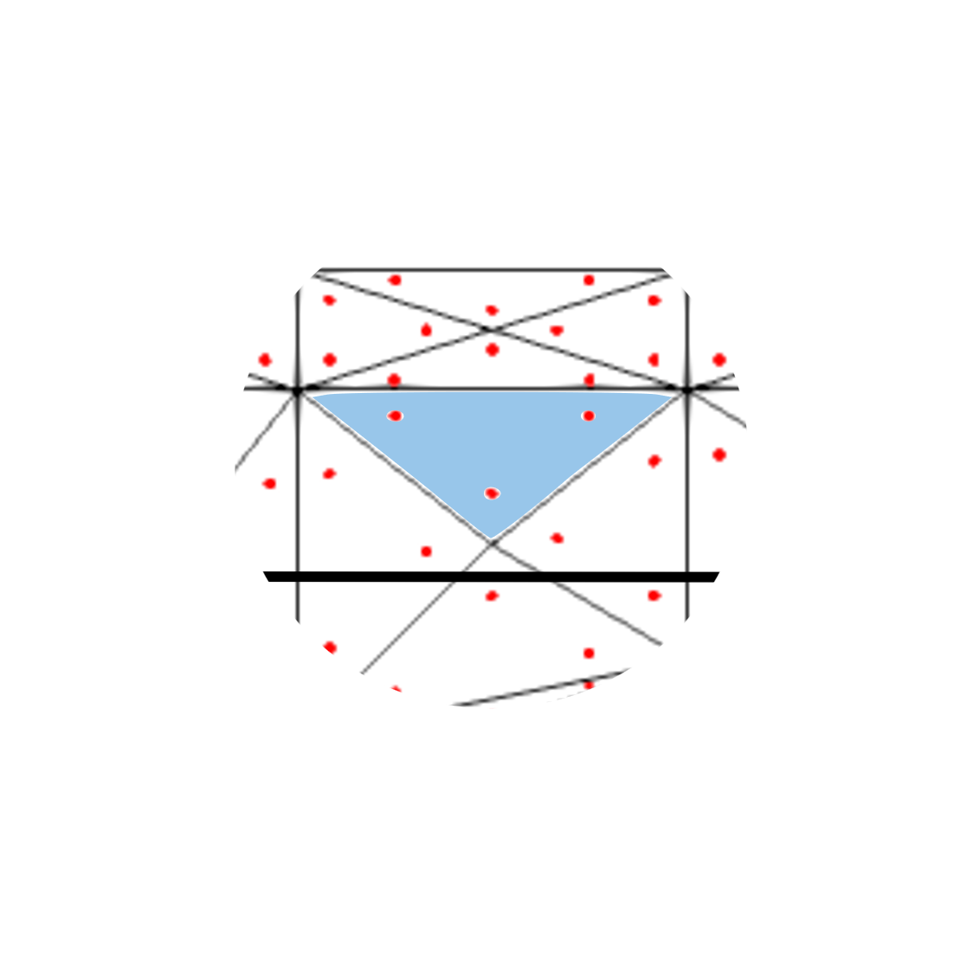
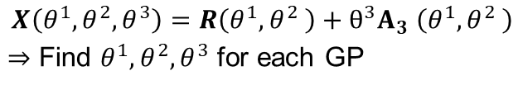
Integration on the coupling interface
$$η$$
x
x
1
x
x
x
x
1
$$ξ$$
Triangle parametric space
Physical space
Projection of integration point to shell interface
$$X\left(θ^{1},θ^{2},θ^{3}\right)=R\left(θ^{1},θ^{2} \right)+θ^{3}A_{3} \left(θ^{1},θ^{2} \right)$$ $⇒$ Find $θ^{1},θ^{2},θ^{3}$ for each GP
x
x
x
x
x
x

Slide 11
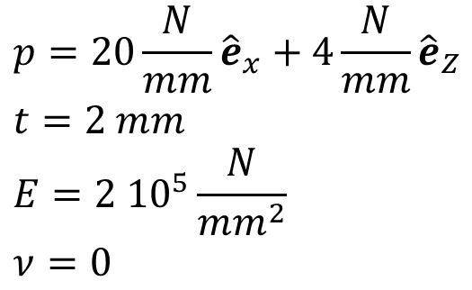
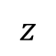
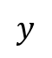
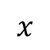
Example 01: Cuboid 20x20x2
Solid
Shell
Kirchhoff-Love (thin) shell
Penalty method
20
p
20
8
$$p=20\frac{N}{mm}{\hat{e}}_{x}+4\frac{N}{mm}{\hat{e}}_{Z} \\ t=2 mm \\ E=2 {10}^{5}\frac{N}{mm^{2}} \\ ν=0$$
$$y$$
$$x$$
$$z$$

Slide 12
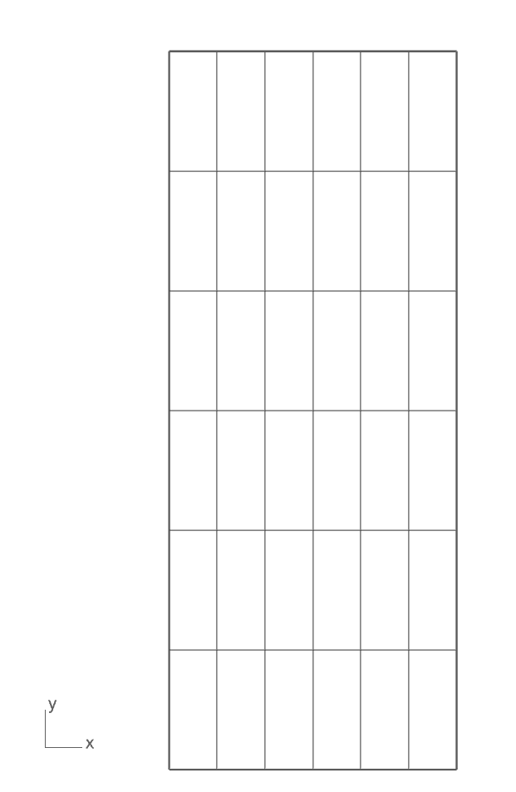
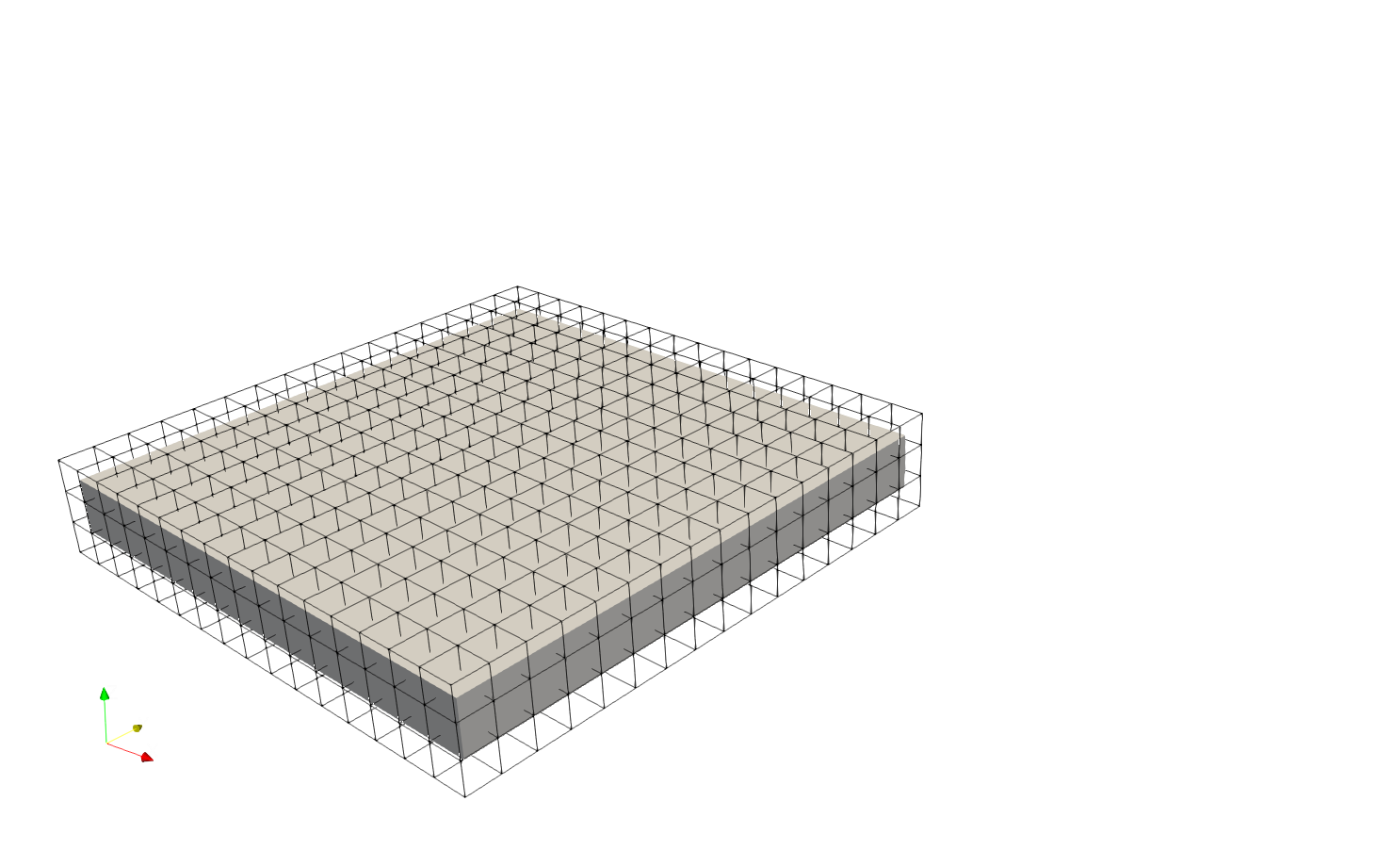
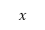
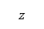
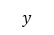
Example 01: Cuboid 20x20x2
$$z$$
$$y$$
$$x$$
(i) Solid part model discretization
(ii) Shell part model discretization

Slide 13
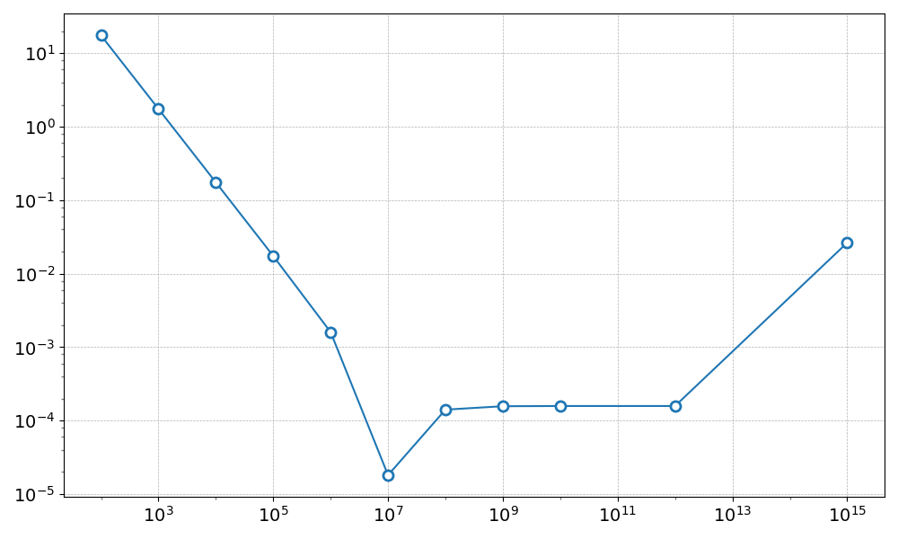
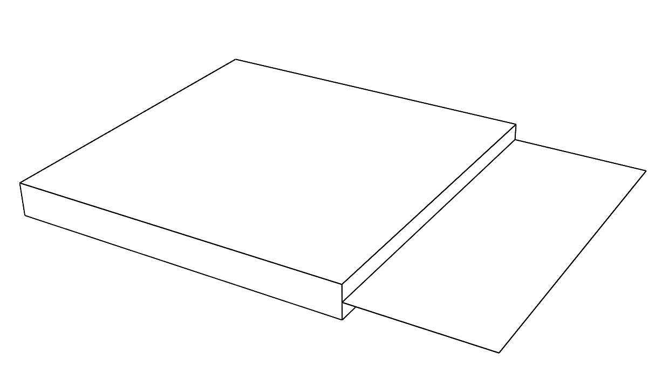
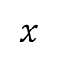
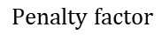
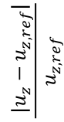
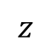
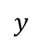
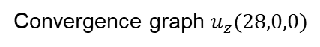
Example 01: Cuboid 20x20x2 – Results
Convergence graph $u_{z}(28,0,0)$
$$\frac{ |u_{z}−u_{z,ref}|}{u_{z,ref}}$$
$$z$$
$$y$$
Point : 28,0,0
$$x$$
$$Penalty factor$$

Slide 14
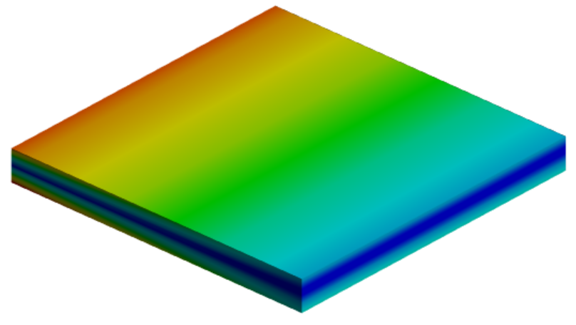


Comparison full solid and coupled (solid part) models
$$α_{pen}={10}^{7}$$
max = 1.79 E+02 MPa
Solid
Shell
max = 1.82 E+02 MPa
(i) Von-Mises stress for full solid model in Ansys (section view)
(ii) Von-Mises stress for solid part of coupled model

Slide 15



max: 2.2001E-01
min: 1.2848E-01
max: 2.1998E-01
min: 1.2848E-01
max: 2.3628E-01
min: 1.1991E-01

Slide 16



Comparison full shell and coupled (shell part) models
$$α_{pen}={10}^{7}$$
max = 2.3833 E+01
max = 2.3836 E+01
(i) Von-Mises stress for full shell model
(ii) Von-Mises stress for shell part of coupled model

Slide 17






Example 02: L-angle
Kirchhoff-Love (thin) shells
Penalty method
4 mm
1 mm
p
9 mm
R = 0.3mm
1 mm
$$p=0.1\frac{N}{mm}{\hat{e}}_{x} \\ t=0.2 mm \\ E=2{ 10}^{5}\frac{N}{mm^{2}} \\ ν=0.3$$
$$z$$
1 mm
$$y$$
Fixed edge (Strong Dirichlet BCS)
$$x$$

Slide 18




Example 02: L-angle
$$y$$
$$x$$
$$z$$
(i) Solid part model discretization
(ii) Shell part model discretization

Slide 19





Example 02: L-angle - Results
Convergence graph $σ_{VM,ref}(−0.1, 9, 0.5)$
$$\frac{ |σ_{VM}−σ_{VM,ref}|}{σ_{VM,ref}}$$
Point : -0.1, 9, 0.5
$$Penalty factor$$

Slide 20



Comparison full solid and coupled (solid part) models
max = 15.1 MPa
$$α_{pen}={10}^{11}$$
max = 16.08 MPa
(i) Von-Mises stress for full solid model in Ansys (section view)
(ii) Von-Mises stress for solid part of coupled model

Slide 21




Example 02: L-angle - Results
$$L2 norm displacement comparison along X−axis$$
$${\left\|u\right\|}_{2}(mm)$$
$$X coordinate (mm)$$

Slide 22





Example 03 – Thick cylinder 270°
Fixed face
Reissner-Mindlin (5pHierarhic) shell
Penalty method
Convergence graph${max⁡(σ}_{VM})$
$$\frac{ |σ_{VM}−σ_{VM,ref}|}{σ_{VM,ref}}$$
$$p=0.4\frac{N}{mm}{\hat{e}}_{x}+0.2\frac{N}{mm}{\hat{e}}_{Z} \\ t=0.9 mm \\ \frac{R}{t}=\frac{4.5}{0.9}=5 \\ E=2 {10}^{5}\frac{N}{mm^{2}} \\ ν=0.3$$
p
$$Penalty factor$$

Slide 23






Example 03 – Thick cylinder 270°
$$z$$
$$z$$
$$x$$
$$y$$
$$x$$
$$y$$
(i) Solid part model discretization
(i) Shell part model discretization

Slide 24



Comparison full solid and coupled (solid part) models
max = 1.391 E+02 MPa
$$α_{pen}={10}^{8}$$
max = 1.360 E+02 MPa
(i) Von-Mises stress for full solid model in Ansys (section view)
(ii) Von-Mises stress for solid part of coupled model

Slide 25





Comparison full solid and coupled (shell part) models
max = 5.364 E+01 mm
$$α_{pen}={10}^{8}$$
max = 5.483 E+01 mm
(i) Displacement $l_{2}$-norm for full solid model (section view)
(ii) Displacement $l_{2}$-norm for shell part of coupled model

Slide 26




Example 04 – Non-conforming parts
Kirchhoff-Love (thin) shell
Nitsche’s method
$$p=5\frac{N}{mm}{\hat{e}}_{x}+1\frac{N}{mm}{\hat{e}}_{Z} \\ t=1 mm \\ E=2 {10}^{5}\frac{N}{mm^{2}} \\ ν=0 \\ b_{stab}= {10}^{6}$$
Fixed face
$$L2 norm displacement comparison along X−axis$$
$${\left\|u\right\|}_{2}(mm)$$
p
$$X coordinate (mm)$$

Slide 27

Conclusion:
+ Method captures the overall structural behavior of the model
+ Idea of projection of Gauss points to shell mid-surface works
- Solid is always the master
- Coupling interface must be flat
Next steps
Compute stabilization factor instead of assigning it a priori in Nitsche’s method
Solve implementation workarounds in Kratos
Perform post-process in one software
Implementation on “glass honeycomb panels”
Research Retreat 2025 | Ricky Aristio

Slide 28

Thank you for your attention!

Slide 29


Artifacts

Slide 30








Variations calculation
$$u^{3p}=v+θ^{3}\left( Φ ×Α_{3}\right)$$
$$u_{,r}^{3p}=v_{,r}+θ^{3}\left( Φ_{,r} ×Α_{3}\right)$$
$$Φ=φ_{1}Α_{1}+φ_{2}Α_{2}$$
$$\frac{∂(.)}{∂u_{r}}$$
$$Φ_{,r}=φ_{1,r}Α_{1}+φ_{2,r}Α_{2}$$
$$φ_{1}=\frac{1}{\left\|Α_{1}×Α_{2}\right\|}v,_{2}∙A_{3}$$
$$φ_{1,r}=\frac{1}{\left\|Α_{1}×Α_{2}\right\|}v,_{2,r}∙A_{3}$$
$$φ_{2}=−\frac{1}{\left\|Α_{1}×Α_{2}\right\|}v,_{1}∙A_{3}$$
$$φ_{2,r }=−\frac{1}{\left\|Α_{1}×Α_{2}\right\|}v,_{1,r}∙A_{3}$$

Slide 31






Variations calculation
$$u^{5p}=v+θ^{3}\left( Φ ×Α_{3}\right)+θ^{3}w$$
$$u_{,r}^{5p}=v_{,r}+θ^{3}\left( Φ_{,r} ×Α_{3}\right)+θ^{3}w_{r}$$
$$w_{,r}=w_{,r}^{1}A_{1}+w_{,r}^{2}A_{2}$$
$$w=w^{1}A_{1}+w^{2}A_{2}$$
First Piola-Kirchhoff traction vector variations (KL Shell)
$$T=P ∙N=F∙S∙N={(g}_{m}⊗G^{m})∙(S^{ij} G_{i }⊗G_{j})∙(N_{k}G^{k} )=S^{ij}N_{j}g_{i}$$
$$\frac{∂T}{∂u_{r}}=\frac{∂S^{ij}}{∂u_{r}}N_{j}g_{i}+S^{ij}N_{j}\frac{∂g_{i}}{∂u_{r}}$$
$$\frac{∂^{2}T}{∂u_{r}∂u_{s}}=\frac{∂S^{ij}}{∂u_{r}∂u_{s}}N_{j}g_{i}+\frac{∂S^{ij}}{∂u_{r}}N_{j}\frac{∂g_{i}}{∂u_{s}}+\frac{∂S^{ij}}{∂u_{s}}N_{j}\frac{∂g_{i}}{∂u_{r}}$$

Slide 32


Wrong projections in Kratos
Shell Gauss points
Solid Gauss points

Slide 33









Integration additional notes
$$K_{rs}^{penalty}=\frac{∂W^{penalty}}{∂u_{r}∂u_{s}}= −α_{pen} \int_{Γ^{c}}{\left(u_{,s}^{so}−u_{,s}^{sh}\right)∙ \left(u_{,r}^{so}−u_{,r}^{sh}\right)dΓ^{c}}= \\ −\sum_{i=1}^{a}{α_{pen} \int_{Γ^{c}}{\left(u_{,s}^{so}−u_{,s}^{sh}\right)∙ \left(u_{,r}^{so}−u_{,r}^{sh}\right)\det\left(J_{i}^{tr}\right)dΓ^{tr}}}$$
solid parametric space
physical space
(solid-shell interface)
$$ξ=ξ (Χ^{so}\left(η\right))$$
triangle parametric space
$$η$$
$$Χ= Χ^{so}=Χ^{so}\left(η\right) \\ Χ= Χ^{sh}=Χ^{sh}\left(η\right)$$
shell parametric space
$$η$$
$$θ=θ (Χ^{sh}\left(η\right))$$
1
$$u_{ }^{so}=u_{ }^{so}\left(ξ\right)=u_{ }^{so}\left(ξ (Χ^{so}\left(η\right))\right) \\ u_{ }^{sh}=u_{ }^{sh}\left(θ\right)=u_{ }^{sh}\left(θ (Χ^{sh}\left(η\right))\right)$$
1
$$ξ$$

Slide 34

Example 04 (Stress concentration)

Slide 35




Example 01: Cuboid 20x20x2 – Results
$$α_{pen}={10}^{7}$$
 | Coupled Model (Solid Part) | Ansys model
Disp X (mm) | -9.801E-03 | -9.804 E-03
Disp Z (mm) | 1.285 E-01 | 1.285 E-01
VM (MPa) | 3.676 E+01 | 3.8 E+01
$$z$$
$$y$$
$$x$$
Point : 20,0,1

Slide 36
Example 02: L-angle - Results
 | Coupled Model (Solid Part) | Ansys model
Disp X (mm) | 3.010E-01 | 2.5172Ε-01
Disp Y (mm) | -4.463E-02 | -3.728Ε-02
Disp Ζ (mm) | -3.493E-07 | -3.451Ε-07
VM (MPa) | 5.593E-01 | 4.939Ε-01
Point : 1, 10.1, 0.5

Slide 37


Example 03 – Cylinder 270°
$$α_{pen}={10}^{8}$$
 | Coupled Model (Solid Part) | Ansys model
Disp X (mm) | 7.494E-04 | 8.364E-04
Disp Y (mm) | -1.229E-02 | -1.345E-02
Disp Ζ (mm) | 1.192E-02 | 1.333E-02
VM (MPa) | 7.100E00 | 1.398E+01
Point : 15, 0, 4.95

Slide 38
Example 01: Cuboid 20x20x2 – Results
 | Coupled Model (Solid Part) | Ansys model
Disp X (mm) | 1.180E-02 | 1.180E-02
Disp Z (mm) | 1.285 E-01 | 1.285 E-01
VM (MPa) | 5.612E+01 | 5.8E+01
$$z$$
$$y$$
$$x$$
Point : 20,0,-1

Slide 39
Example 02: L-angle - Results
 | Coupled Model (Solid Part) | Coupled Model (Shell Part) | Ansys model
Disp X (mm) | 2.520E-01 | 2.520E-01 | 2.108Ε-01
Disp Y (mm) | 9.625E-09 | 5.901E-09 | 4.017Ε-09
Disp Ζ (mm) | 2.889E-08 | 2.699Ε-08 | 2.169Ε-08
VM (MPa) | 1.556E+00 | - | 3.343Ε+00
Point : 0, 9, 0.5

Slide 40
Example 02: L-angle - Results
 | Coupled Model (Solid Part) | Coupled Model (Shell Part) | Ansys model
Disp X (mm) | 2.966E-01 | 2.965E+00 | 2.480Ε+00
Disp Y (mm) | -4.463E-02 | -4.465E-02 | -3.728Ε-02
VM (MPa) | 4.682E-01 | - | 4.922E-01
Point : 1, 10, 0.5

Slide 41



Example 01: Cuboid 20x20x2 – Results
 | Coupled Model (Solid Part) | Ansys model (Full Solid)
Disp X (mm) | 1.000E-03 | 1.000E-03
Disp Z (mm) | 1.285 E-01 | 1.285 E-01
VM (MPa) | 1.107E+01 | 1.137E+01
$$z$$
$$y$$
 | Coupled Model (Shell Part) | Kratos model (Full Shell)
Disp X (mm) | 1.001E-03 | 9.928E-04
Disp Z (mm) | 1.280E-01 | 1.285E-01
VM (MPa) | - | -
$$x$$
Point : 20,0,0

Slide 42

Example 02: L-angle - Results
$$α_{pen}={10}^{11}$$
 | Coupled Model (Shell part) | Ansys model
Disp X (mm) | 2.966E+00 | 2.480E+00
Disp Y (mm) | -2.232E-01 | -1.864E-01
Point : 15, 10, 0.5

Slide 43
Example 03 – Cylinder 270°
Point : 15, 0, 4.95
 | Coupled Model (Solid Part) | Ansys model
Disp X (mm) | 7.494E-04 | 8.364E-04
Disp Y (mm) | -1.229E-02 | -1.345E-02
Disp Ζ (mm) | 1.192E-02 | 1.333E-02
VM (MPa) | 7.100E00 | 1.398E+01

Slide 44
Example 03 – Cylinder 270°
Point : 15, 4.5, 0
 | Coupled Model (Shell Part) | Ansys model
Disp X (mm) | -4.299E-03 | -4.419E-03
Disp Y (mm) | -3.835E-03 | -5.289E-03
Disp Ζ (mm) | 1.578E-02 | 1.675E-02

Slide 45

Example 03 – Thick cylinder 270°
 | Coupled Model (Shell Part) | Ansys model
Disp X (mm) | 1.953E-03 | 2.090E-03
Disp Y (mm) | -3.597E-02 | -3.854E-03
Disp Ζ (mm) | 3.573E-02 | 3.895E-02
$$α_{pen}={10}^{8}$$
Point : 30, 0, 4.5

Slide 46
Example 02: L-angle - Results
 | Coupled Model (Solid Shell) | Ansys model
Disp X (mm) | 2.966E+00 | 2.480E+00
Disp Y (mm) | -2.232E-01 | -1.864E-01
Point : 1, 10, 0.5

Slide 47

Example 04 – Non-conforming parts
Fixed face
Kirchhoff-Love (thin) shell
Nitsche’s method
$$p=5\frac{N}{mm}{\hat{e}}_{x}+1\frac{N}{mm}{\hat{e}}_{Z} \\ t=1 mm \\ E=2 {10}^{5}\frac{N}{mm} \\ ν=0 \\ b_{stab}= {10}^{6}$$
Point : 18, -3, 0
 | Coupled Model (Shell Part) | Ansys model
Disp X (mm) | 2.526E-04 | 2.524E-04
Disp Ζ (mm) | 1.174E-02 | 1.230E-02
p

Slide 48
x
x
x
x
x
x
x
x
x

